Slide 1
API gateways and service meshes
Opening the door to application modernization
Girish Krishnan, Principal Solutions Architect
Vijay Chintalapati, Sr Solutions Architect
Vinay Bhalerao, Sr Solutions Architect

Slide 2

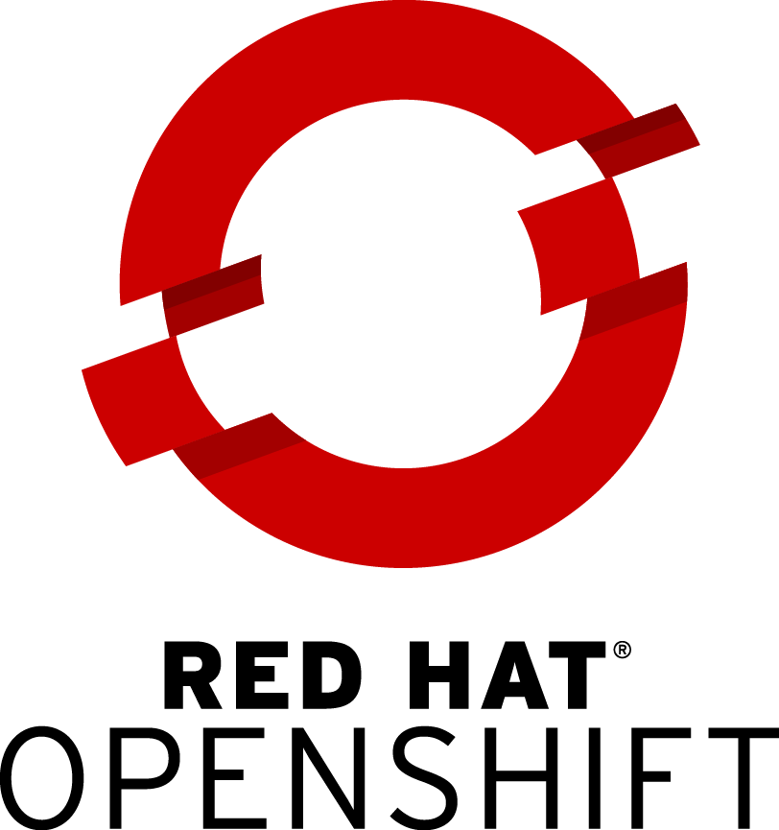



Distributed services with Red Hat OpenShift
Service
CONTAINER
Service
CONTAINER
Service
CONTAINER
Service
CONTAINER
Service
CONTAINER
ANY
APPLICATION
SERVICE
API vs Service Mesh
API BUSINESS
API Management
Monetization | Dev Portal | Analytics | Authentication | Authorization
SERVICE OPS
OpenShift Service Mesh (Istio + Jaeger + Kiali+Adapter for API Management)
OpenShift Container Platform
(Enterprise Kubernetes)
INFRA OPS
ANY
INFRASTRUCTURE
INFRA
Laptop
Datacenter
OpenStack
Amazon Web Services
Microsoft Azure
Google Cloud
Notes:
Thank you Adrienne. OpenShift is Red Hat’s Enterprise Kubernetes based Container Platform. What makes Red Hat OpenShift compelling to 3000+ customers is a comprehensive platform to develop, build and run any application on any infrastructure. We deliver on this vision in large part thru the 5 service domains that make up OpenShift. While these service domains are not listed on the slide - they are familiar to those who have been part of an OpenShift presentation or demonstration in the past.
These 5 service domains are Cluster, Platform, Application, Data and Developer. These service domains are both persona-centric and workload specific. Today’s conversation will focus on OpenShift Service Mesh, a Platform level Service and API Management, an Application level Service. Over to you Vijay and the next slide.

Slide 3







OpenShift Service Mesh
Connect, Secure, Control and Observe Services on OpenShift
Services
A software infrastructure layer between Kubernetes and your services for managing communications.
Handles common “microservice” challenges, so that developers don’t have to:
Security
Monitoring & Observability
Application Resilience
Upgrades, Rollouts & A/B Testing
And more...
F
Envoy
Envoy
Envoy
OpenShift Service Mesh
Istio
Kiali
Jaeger
OPENSHIFT
Red Hat Enterprise Linux CoreOS
Physical
Virtual
Private cloud
Public cloud
Notes:
Thanks Girish!
Openshift Service Mesh is a software based infrastructure layer that makes discovery, management and observability of the service-to-service communication between microservices possible without them requiring any code change. OpenShift service mesh deploys a side car to microservices called Envoy Proxy which controls its inbound and outbound traffic . Now, since all the Envoy proxies can be configured and managed via Istio we are able to achieve functionality such as
Service to Service mutual TLS
Custom Load Balancing
Rate limiting
Traffic splitting
Testing methodologies such as A/B testing, Fault Injection
and many more
Next slide please!

Slide 4
Why Service Mesh?
An Abstraction for Microservice Challenges
Service Mesh solve distributed systems challenges at a common infrastructure layer.
This reduces boilerplate code and copy/paste errors across services.
Enforces common policies across all services.
Removes the obligation to implement cross cutting concerns from developers.
Services
Without Service Mesh
Service
Services
With Service Mesh
Security Code
Metrics & Tracing Code
Service
Failure Handling Code
Traffic Management Code
...and more boilerplate code.
Service Mesh
Container Platform
Container Platform
Notes:
Imagine your Software Development teams not having to ever worry about packaging libraries into their applications to support all the functionality that we just heard and focus solely on delivering code that address the core business needs.
Also imagine for your DevOps teams, the ability to enforce policies across multiple services uniformly and centrally, without having to touch many infrastructure related components. That is the power of OpenShift Service Mesh and it is absolutely vital for future generations of microservices on Kubernetes platform.
So Vinay! can you help us understand how we can do API management through Service Mesh ?

Slide 5




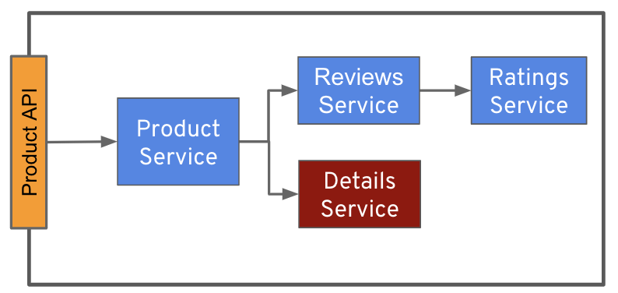
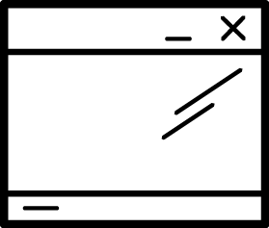

Red Hat API Management
API Management
Monetization | Dev Portal | Analytics | Authentication | Authorization
API Manager
API Consumers (External and Internal Application Developers)
Developer Portal
Admin Portal
API Provider
(Line Of Business / Product Manager,
Developers, Writers, Ops)
API Request
Product API
Authorized API Request
Applications
API Gateway
API Backend
Notes:
Let’s first see how API Management works and it fits into microservices architecture
Ideally you would like to protect your API backend i.e microservices. In that case, you will need to place an API Gateway between the applications and API backend
So when the request hits the API Gateway, the API Gateway enforces the authentication and authorization rules you had defined in the API Manager. After it’s successful, it then proxies the request to the API backend
The API Manager not only provides a control plane for Authentication and authorization rules but also provides with rich enhanced features like Monetization, analytics and developer portal for the developers to signup.

Slide 6
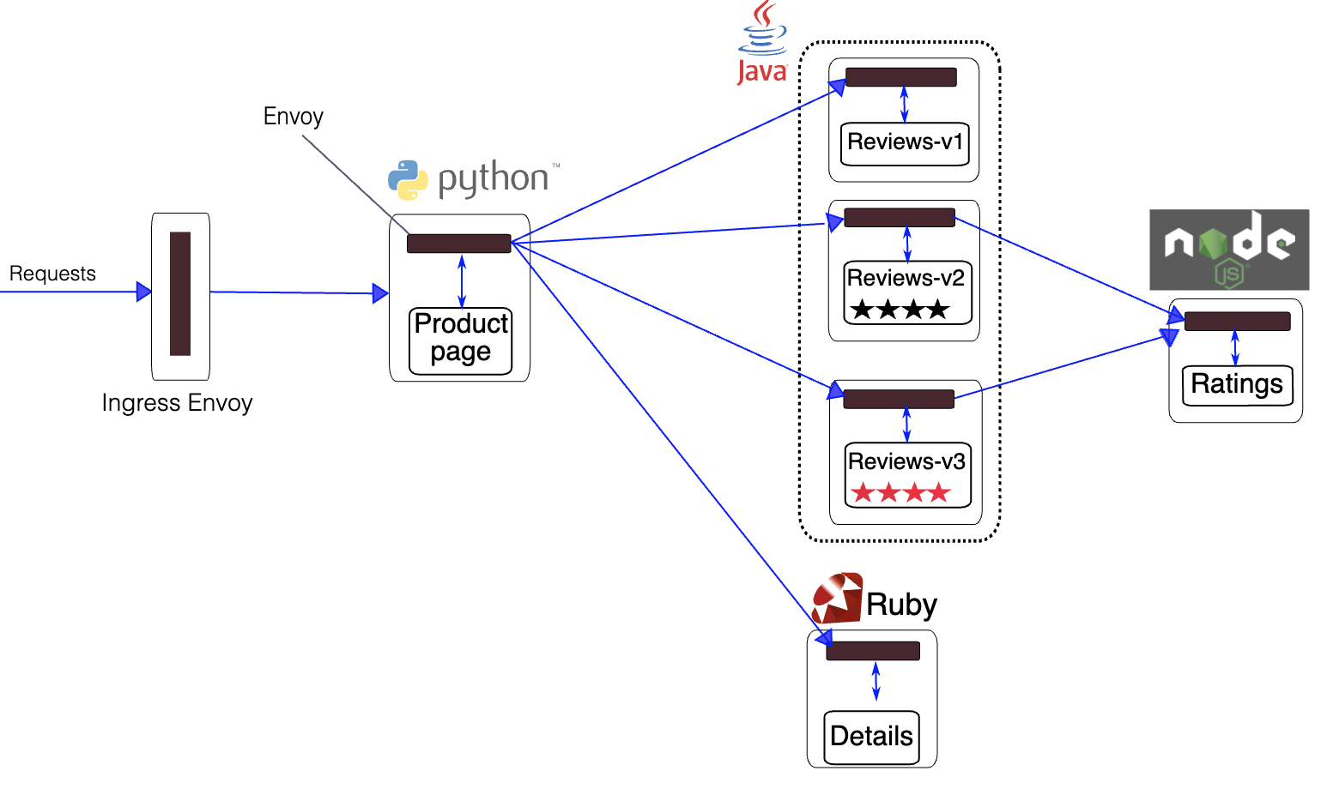




Service Mesh + API Manager Integration
Microservice Architecture with Service Mesh & API Gateway
API Consumers
Istio Control Plane
Integrated approach using 3scale Adapter
Single control plane
Single Ingress/Gateway
Cache authorization policies
API Management Adapter
API Manager
Developer Portal
Admin Portal
Notes:
Now let’s see how API Management will get integrated with Servicemesh
This is done using the API Management Istio adapter - 3scale. It is a software component that integrates with the Istio Mixer. Istio Mixer mediates communication to and from services.
---
When a request arrives in the Service Mesh, Envoy generates attributes from request, response and the environment. Mixer processes attributes and routes them to adapters according to its configuration. Adapters receive the request and handle it.
The 3scale adapter communicates with the Service Management API, authorises requests and reports usage. At last, it will then send the request to the microservices.
---
It complements other policies in Mixer that you would usually have in API Gateway
---

Slide 7
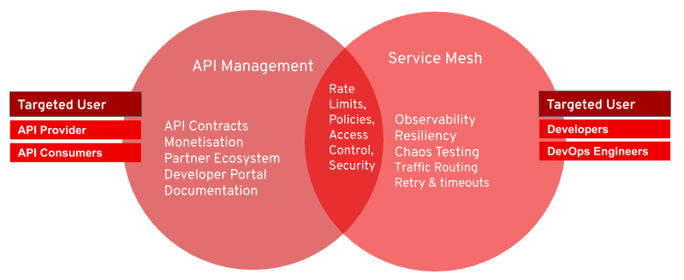
API Management vs Service Mesh
API Management
Service Mesh
Manage the relationship
between APIs/Services
and their consumers
Deliver advanced traffic control, security, resilience and observability for cloud-native applications
Notes:
Use API management to administer relationships between exposed services and consumers. API management is best for:
► North-south traffic patterns.
► Interdomain traffic.
► API-led development situations in which not all platforms can access a service mesh.
In general, API management is not appropriate for connecting services or microservices that are part of the same business domain.
Deploy service meshes when you need advanced traffic control, security, resilience, and observability for microservices and cloud-native applications. Service meshes are best for:
► East-west traffic patterns.
► Intradomain traffic.
Avoid using service meshes in situations in which service consumers require formal documentation, billing, application use plans, and third-party authorization.
In closing, the most effective service management architectures combine API management and service meshes to deliver the right capabilities for the right traffic at the right time. Use API management for north-south traffic patterns that cross domain or enterprise boundaries and service meshes for east-west traffic patterns that stay within those boundaries. Back to you Adrienne.

